Slide 1
SSBSC Modulation and Demodulation Expt. No- 4

Slide 2
SSBSC Modulation and Demodulation
SSB-SC modulation using Hilbert transform in time domain and using FFT represent the result in frequency domain and hence reconstruct the modulating signal using Butterworth filter.
The method to produce the SSB signal is to remove one of the sidebands via filtering, leaving only either the upper sideband (USB), the sideband with the higher frequency, or lower sideband (LSB), the sideband with the lower frequency.
Most often, the carrier is reduced or removed entirely (suppressed), being referred to in full as single sideband suppressed carrier (SSBSC).

Slide 3
Hilbert Transform:
The Hilbert transform facilitates the formation of the analytic signal.
The analytic signal is useful in the area of communications, particularly in bandpass signal processing.
The toolbox function Hilbert computes the Hilbert transform for a real input sequence x and returns a complex result of the same length, y = hilbert(x), where the real part of y is the original real data and the imaginary part is the actual Hilbert transform.
y is sometimes called the analytic signal, in reference to the continuous-time analytic signal.
A key property of the discrete-time analytic signal is that its Z-transform is 0 on the lower half of the unit circle.
Many applications of the analytic signal are related to this property; for example, the analytic signal is useful in avoiding aliasing effects for bandpass sampling operations. The magnitude of the analytic signal is the complex envelope of the original signal.
The Hilbert transform is related to the actual data by a 90-degree phase shift; sines become cosines and vice versa. To plot a portion of data and its Hilbert transform, use

Slide 4
SSBSC Modulation and Demodulation Algorithm:
1. Initialize Amplitude and frequency for both message and carrier signal, N point DFT samples, time vector.
2. Generate message signal and carrier signal sine and cosine (both).
3.Apply Hilbert transform to the message signal.
4.Write the expression for LSB or USB as per the requirement.
LSB=message*carrier(cosine)+Hilbert transform of message *carrier(sine)
USB=message*carrier(cosine)-Hilbert transform of message *carrier(sine)
5. Take Fourier transform LSB or USB to get the desired frequency spectrum for modulated signal.
Plot the signals
6. For the demodulation, multiply LSB with carrier (cosine) and apply Butterworth filter to get demodulated signal or multiply USB with carrier (sine ) and apply Butterworth filter to get demodulated signal.

Slide 5
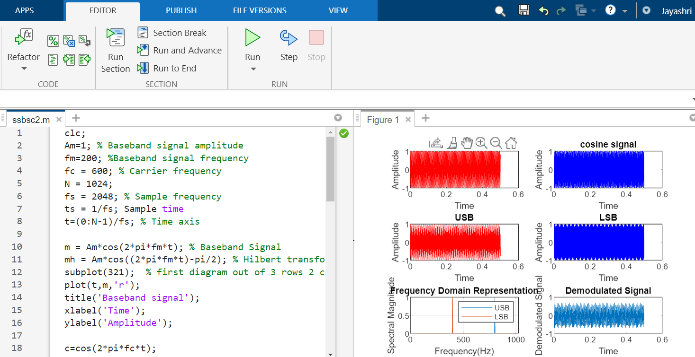
Output:

Slide 6
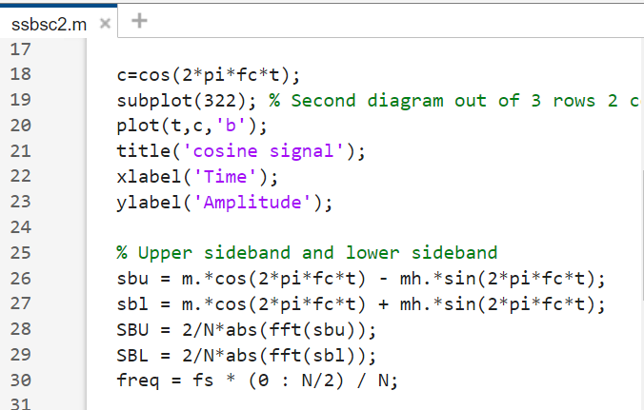
Code:

Slide 7
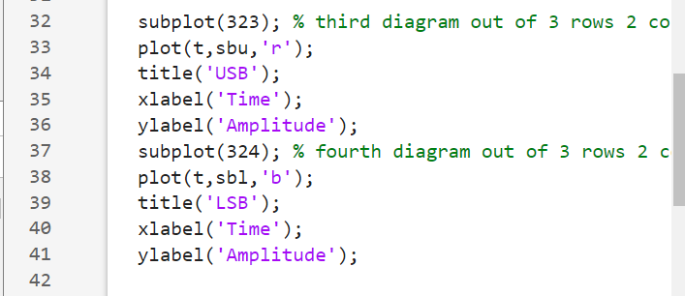
Code:

Slide 8
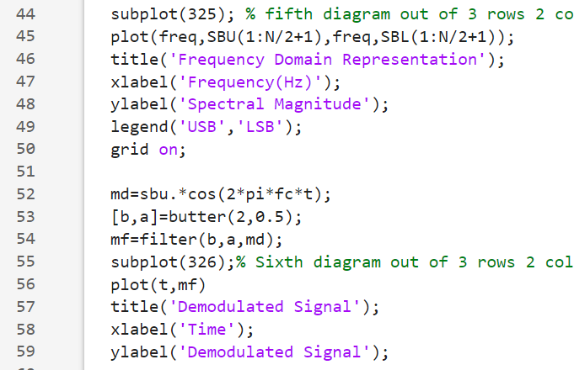
Code:

Slide 9
Note:
Remove the lower sideband and write the code only by considering the upper sideband.

Slide 10
References:
[1] https://www.geeksforgeeks.org/single-side-band-ssb-modulation-u sing-matlab/
[2] “B.P.Lathi”, Modern Digital and Analog Communication Systems Chapter 4, Page no.173 and 174.
[3] https://in.mathworks.com/help/signal/ug/hilbert-transform.html

